Slide 1
SUMMER
Activities
Spotlight 5 Module 10

Slide 2

sunbathing

Slide 3
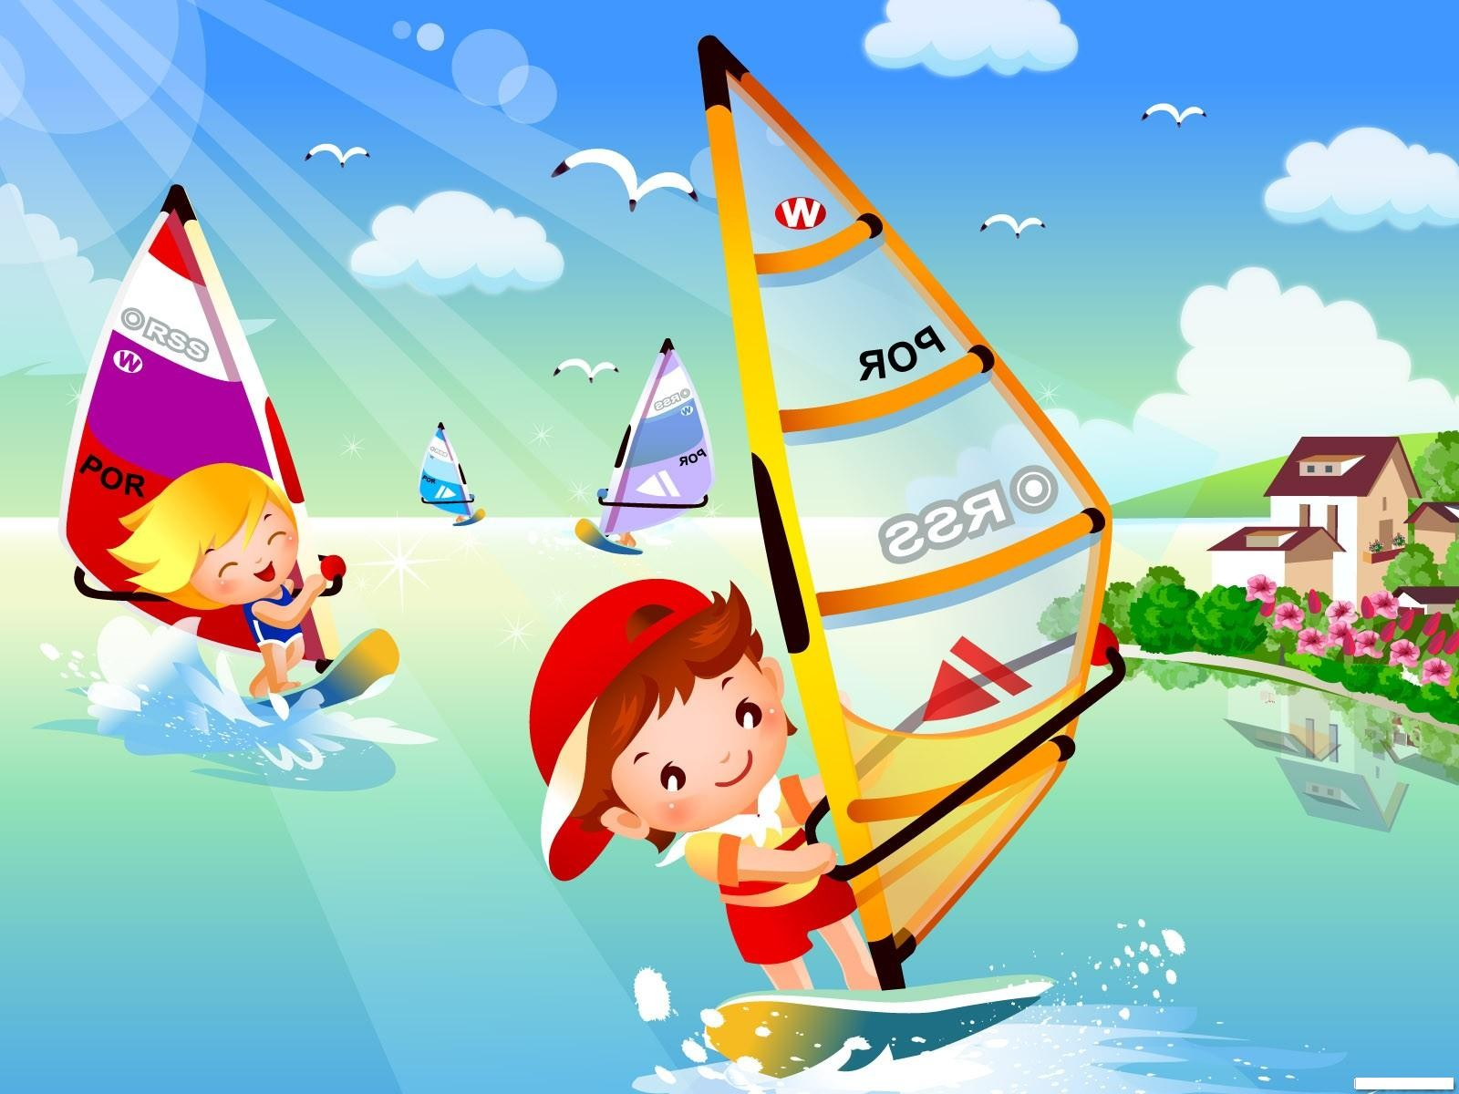
sailing

Slide 4
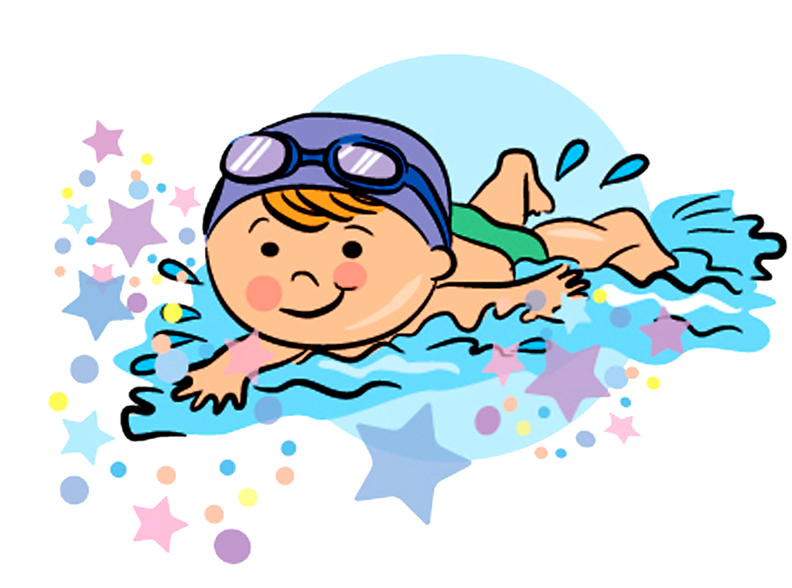
swimming

Slide 5
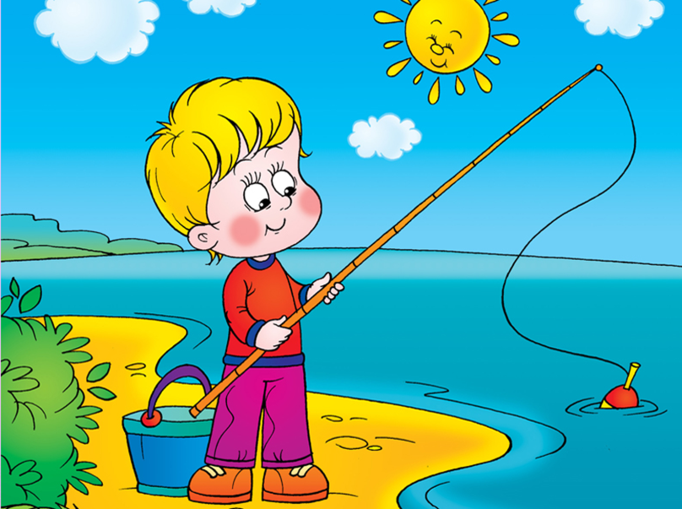
fishing

Slide 6

hiking

Slide 7
Feeling
tiring –утомительный
boring - скучный
dangerous - опасный
relaxing –расслабляющий, спокойный
exciting-волнующий, захватывающий
fun –веселый
enjoyable-приятный

Slide 8
Fill in the gaps with: tiring, fun, relaxing, dangerous (2), boring.
1. Hiking is hard work. It’s very ________________.
2. I don’t enjoy sunbathing. I find it ____________.
3. I can’t swim, so I won’t ever go white water rafting because it will be ____________.
4. I think fishing is very quiet and ______________.
5. I never go scuba diving because it is _____________.
6. I want to try sailing. I think it will be lots of ___________.

Slide 9
Keys:
1. Hiking is hard work. It’s very tiring_.
2. I don’t enjoy sunbathing. I find it boring.
3. I can’t swim, so I won’t ever go white water rafting because it will be dangerous_.
4. I think fishing is very quiet and relaxing.
5. I never go scuba diving because it is dangerous_.
6. I want to try sailing. I think it will be lots of fun.

Slide 10
Fill in the gaps :
1. - in the sea.
2. - on the beach.
3. - sport games.
4. - campfires.

Slide 11
Fill in the gaps :
1. swim in the sea.
2. sunbathe on the beach.
3. play sport games.
4. enjoy campfires.

Slide 12
Types of holiday
a hiking holiday
a cruise
a beach holiday
a camping holiday
a sightseeing tour
an activity holiday

Slide 13

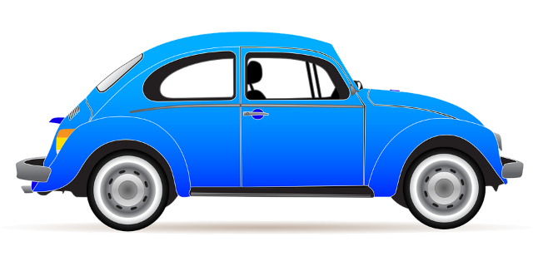
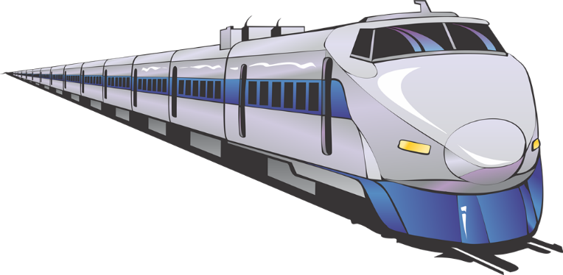

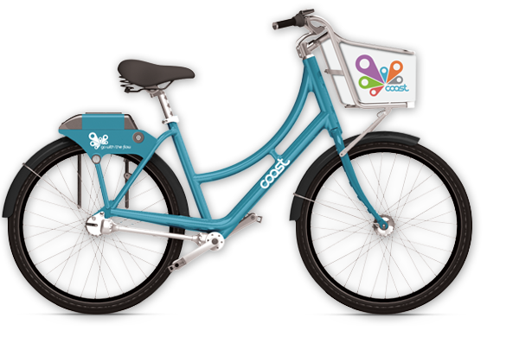
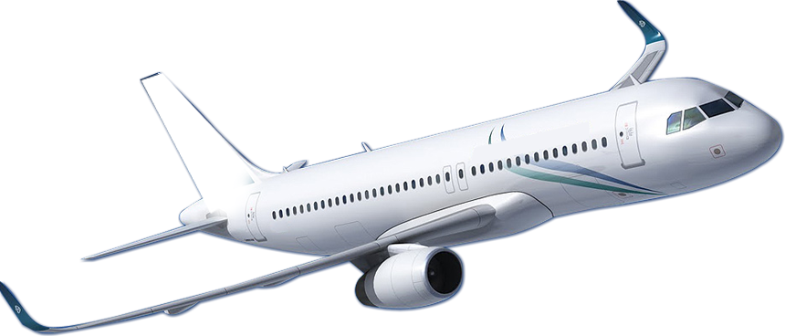
Let’s Travel
by bus/coach
by car
by train
by ship
by bike
by plain

Slide 14
Задание : составьте небольшой рассказ о своем любимом виде отдыха летом. Расскажите, каким транспортом вы любите путешествовать, что любите делать и какие чувства вызывает у вас отдых.
Образец рассказа ученика:
My favourite type of holidays is a beach holiday. I like travelling by car there. In summer I like swimming in the sea and sunbathing on a sandy beach. It is very relaxing.

